Slide 1


Movies
Pooja Sri Tripuraneni
Kedar Sedai
Pujan Bohora
CS7810
Advised By Cogan Shimizhu

Slide 2
Overview
Introduction
Modules
- Schema Diagrams
- Description
- Axioms
AllTogether
Competency Questions
SPARQL Queries
Demo
Retrospective

Slide 3
Introduction

Slide 4
Introduction
The evolving entertainment industry and the rise of streaming platforms demand advanced tools to analyze movie performance, audience preferences and industry trends.
A knowledge graph connects key entities like actors, directors, budget and ratings, offering insights into patterns and relationships.
Integrating economic factors like inflation into movie analysis uncovers the financial impacts on production budgets and gross earnings.
This approach empowers stakeholders with data-driven decision-making for both creative and financial strategies.

Slide 5
Modules

Slide 6
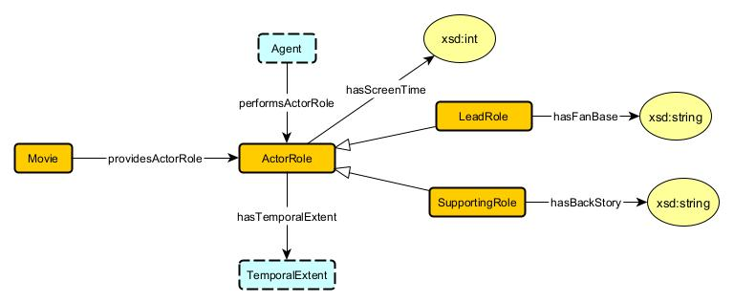
1. Actor
Actors play a pivotal role in bringing characters to life, enhancing the storyline, and shaping the viewer’s experience. Tracking their roles enables analysis of casting trends, star power, and performance impact, aiding talent management and narrative development.
Source Pattern : Agent Role Pattern
Source Data : TMDb, IMDb

Slide 7
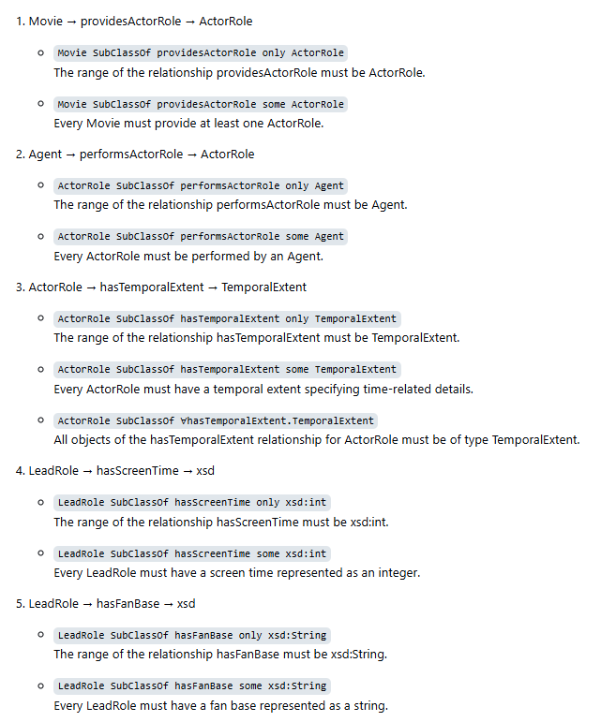
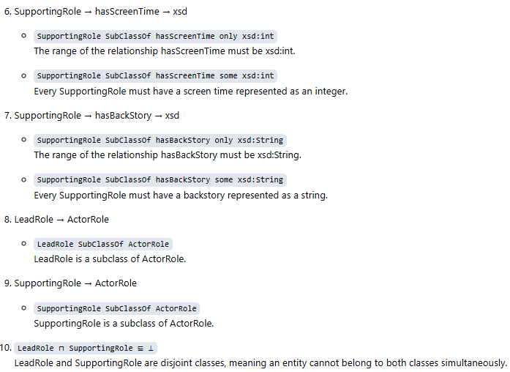
Axioms

Slide 8
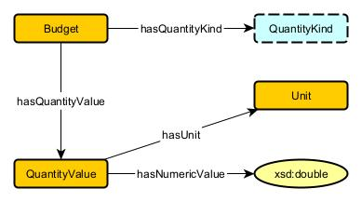
2. Budget
Budget defines financial resources for production, guiding planning, resource allocation, and profitability forecasting while assessing financial risks in investments.
Source Pattern : Quantity Pattern
Source Data : TMDb, IMDb

Slide 9
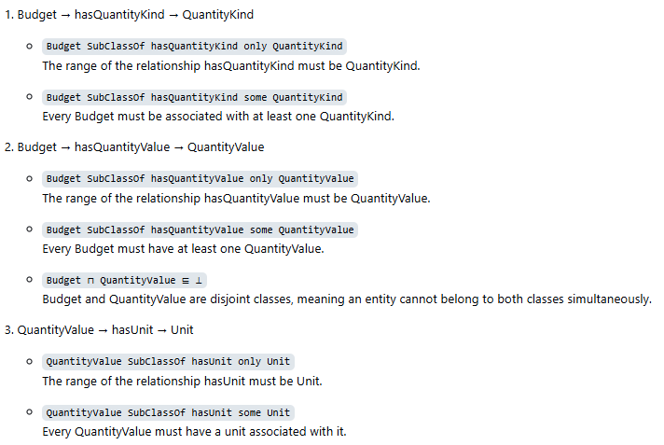
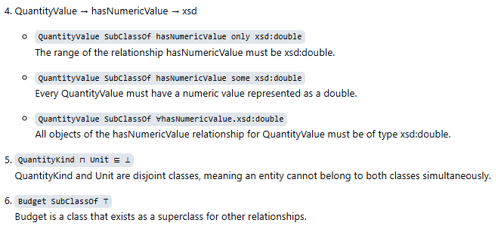
Axioms

Slide 10
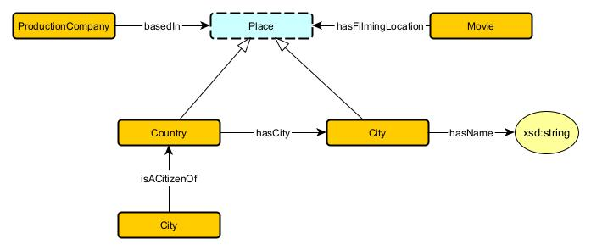
3. Country
Country provides geographic context for movie production, filming, or release, highlighting cultural influences, market targeting, and regional distribution strategies.
Source Pattern : Place Pattern (GeoSPARQL)
Source Data : TMDb, IMDb

Slide 11
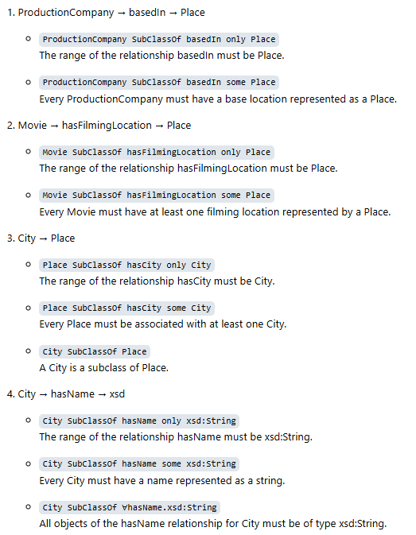
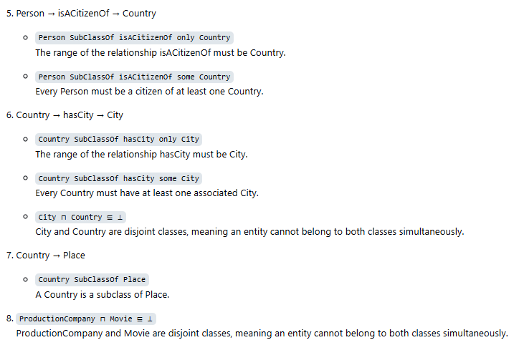
Axioms

Slide 12
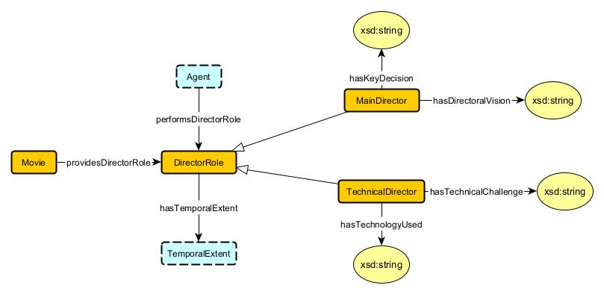
4. Director
Directors shape a movie’s creative vision, coordinating with cast and crew to influence its artistic style, genre trends, box office performance, and critical reception.
Source Pattern : Agent Role Pattern
Source Data : TMDb, IMDb

Slide 13
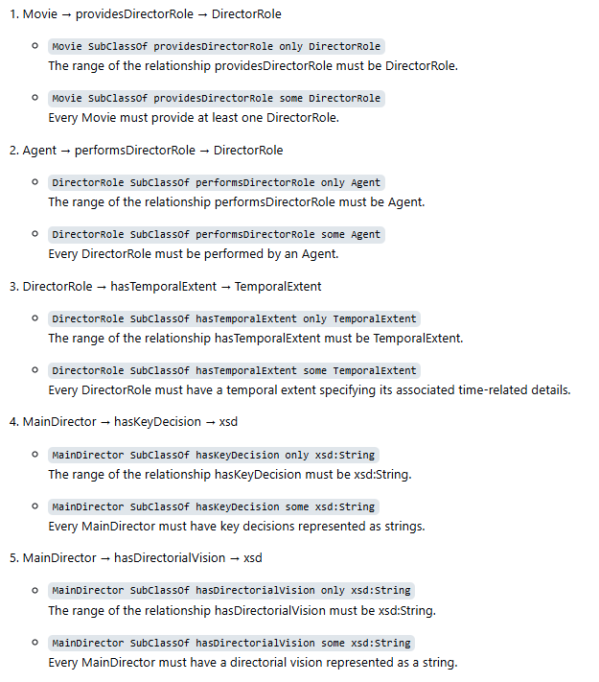
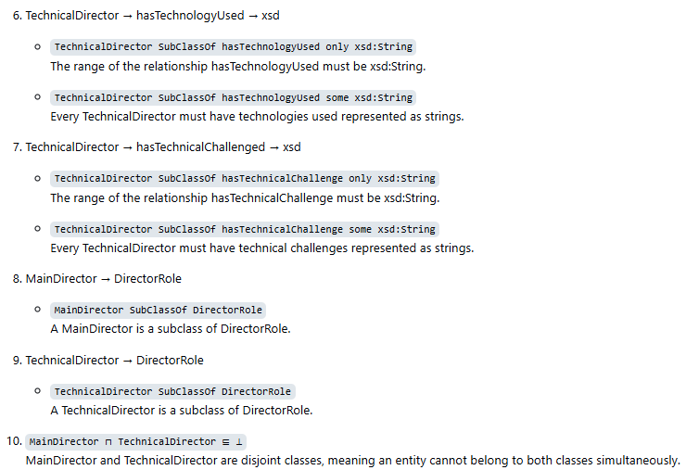
Axioms

Slide 14
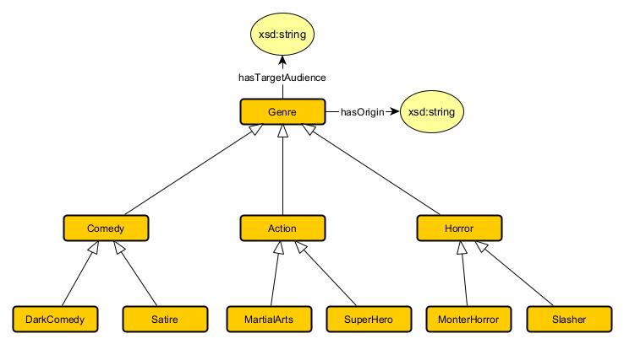
5. Genre
Genre categorize movies based on themes, storytelling styles, or visual aesthetics helping users, producers and researchers identify similar movies, track trends, target audiences and study genre evolution.
Source Pattern : Classification Pattern (MODL)
Source Data : TMDb, IMDb

Slide 15
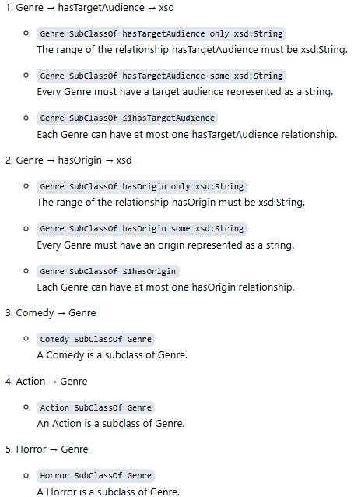
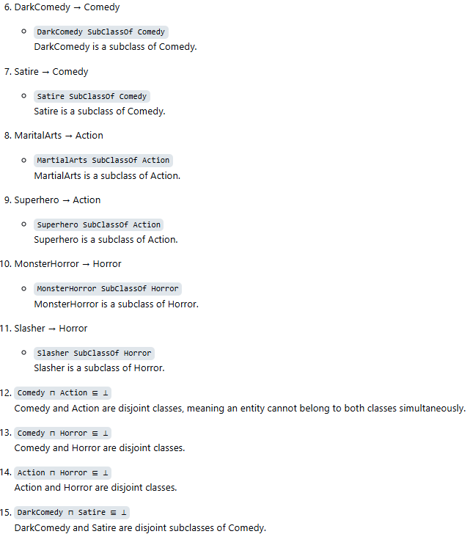
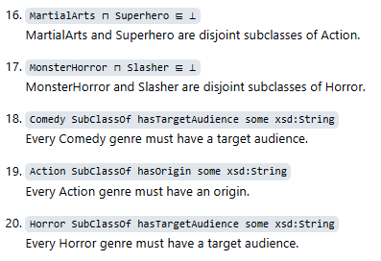
Axioms

Slide 16
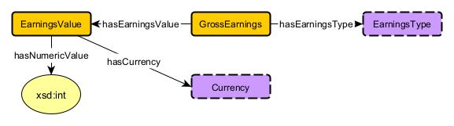
6. Gross Earnings
Gross Earnings reflect total revenue from box office, streaming, and other channels, serving as a key metric for financial success, profitability, and consumer demand analysis.
Source Pattern : Quantity Pattern
Source Data : TMDb, IMDb

Slide 17
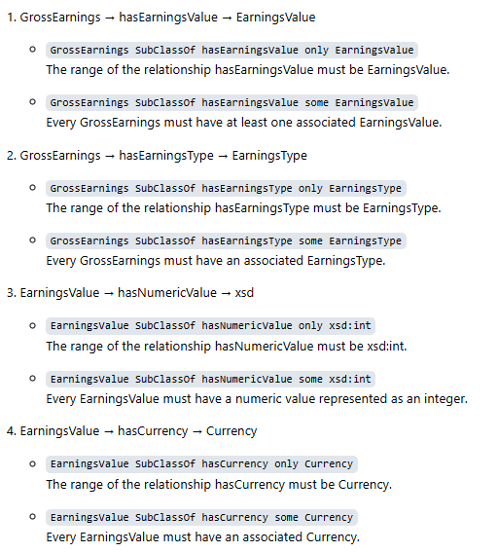
Axioms

Slide 18
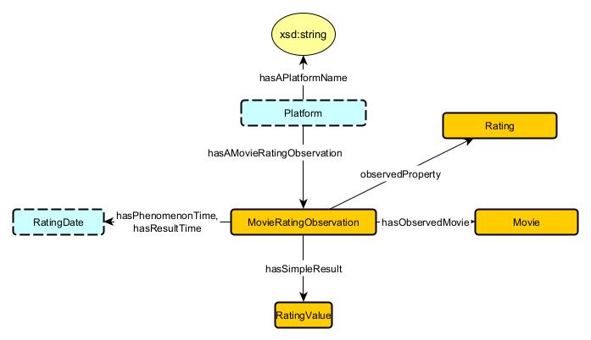
7. Movie Ratings
Ratings provide a standardized measure of movie quality, influencing audience choices, marketing strategies, and box office success while reflecting critical and audience reception.
Source Pattern : Observation Pattern
Source Data : TMDb, IMDb

Slide 19
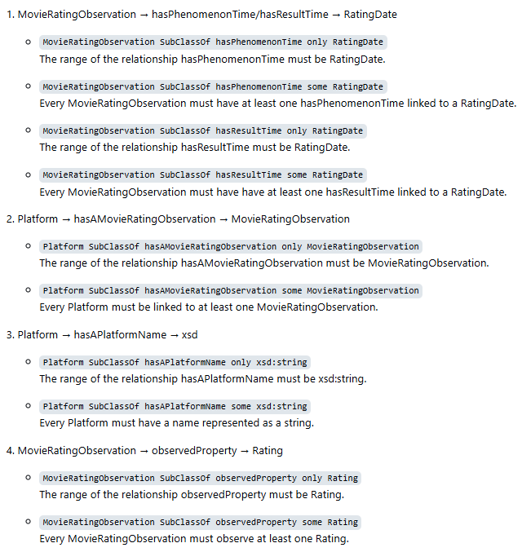
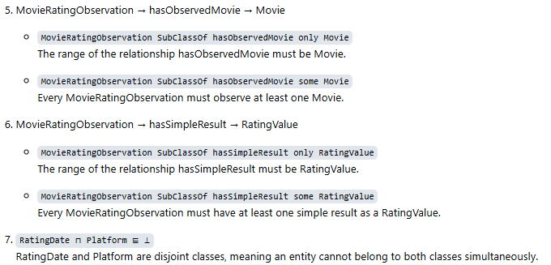
Axioms

Slide 20
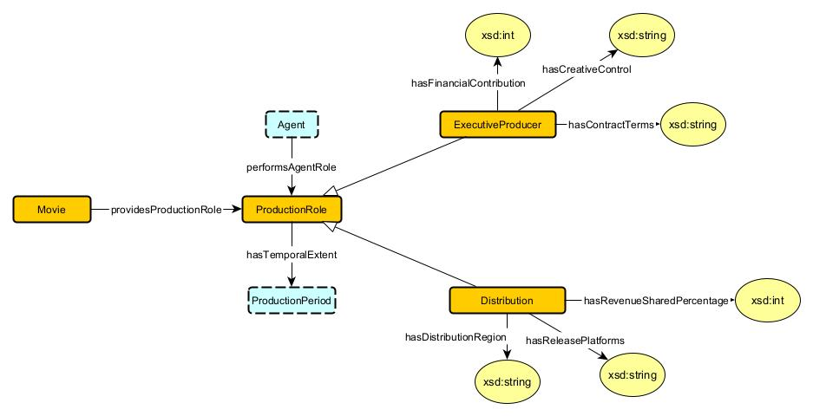
8. Production Companies
Production companies finance and manage movie creation, driving industry trends, partnerships, and success while shaping investment patterns and genre impact.
Source Pattern : Agent Role Pattern
Source Data : IMDb, TMDb

Slide 21
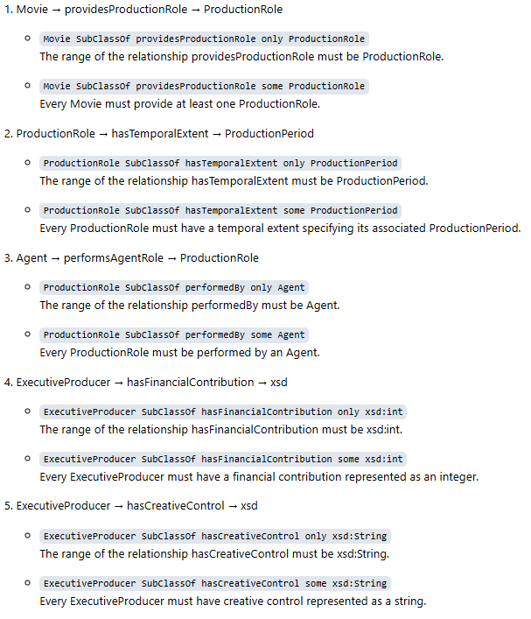
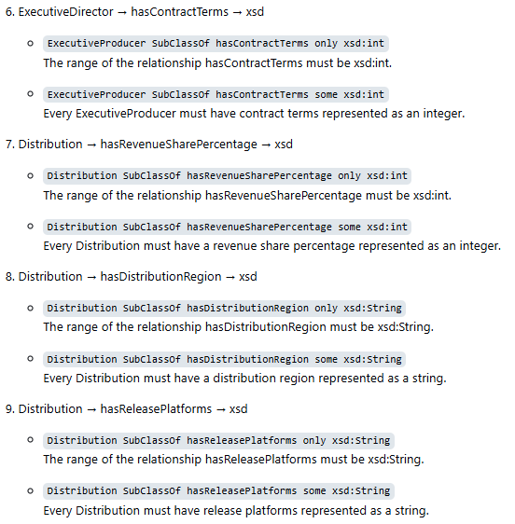
Axioms

Slide 22
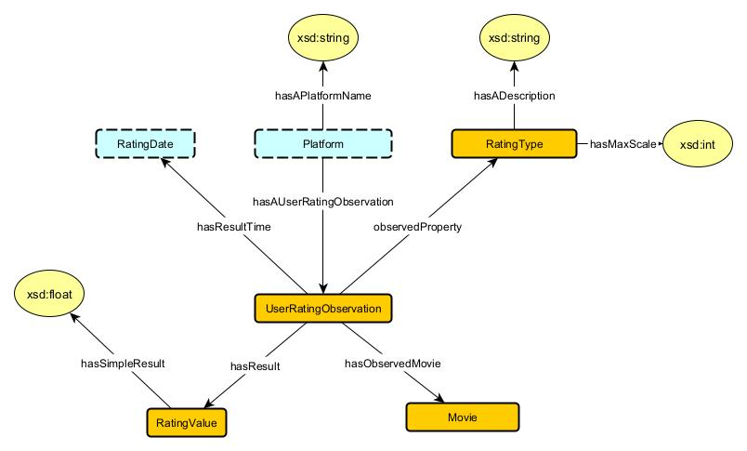
9. User Ratings
User Ratings reflect audience satisfaction, offering insights into sentiment, long-term appeal, and the influence on future viewers and marketing strategies.
Source Pattern : Observation Pattern
Source Data : TMDb, IMDb

Slide 23
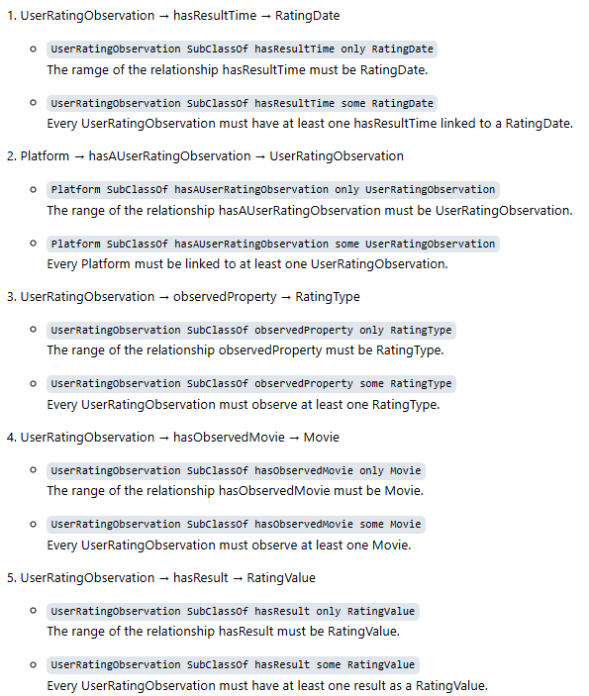
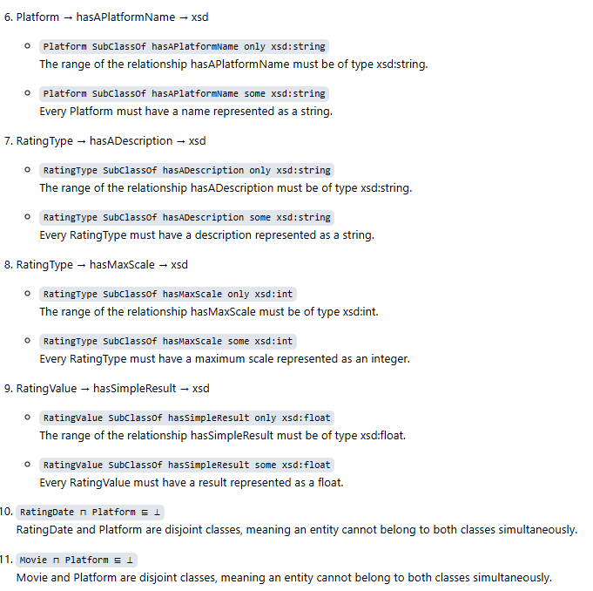
Axioms

Slide 24
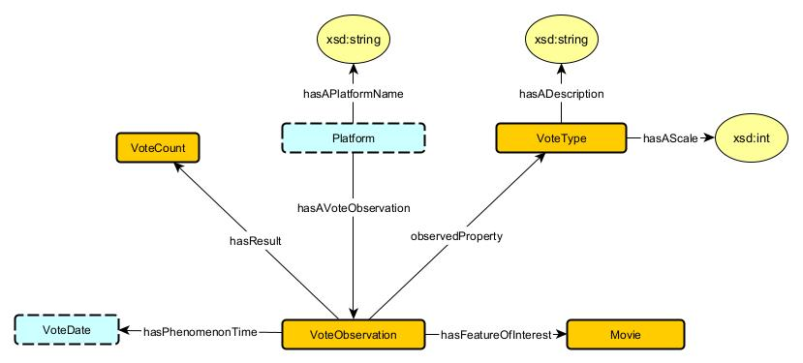
11. Votes
Votes quantify audience engagement, reflecting a movie’s popularity, social influence, and viewer sentiment, offering insights into audience reach and approval.
Source Pattern : Observation Pattern
Source Data : TMDb, IMDb

Slide 25
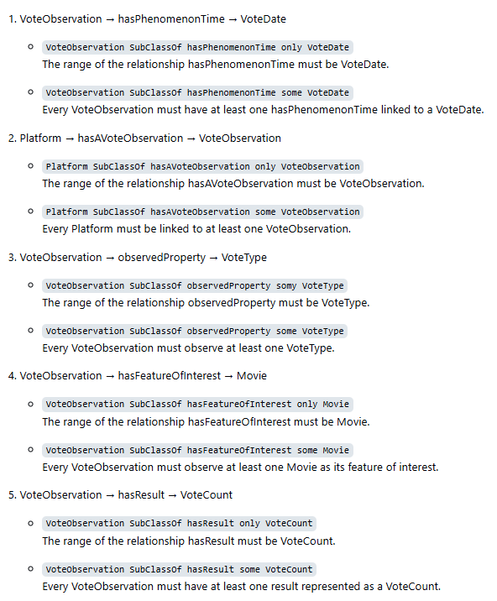
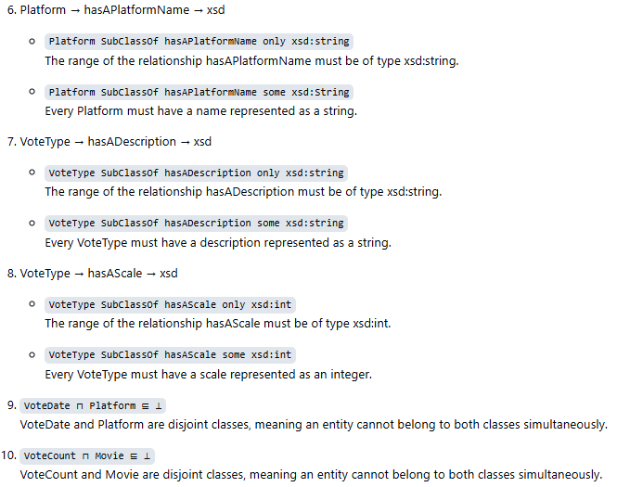
Axioms

Slide 26
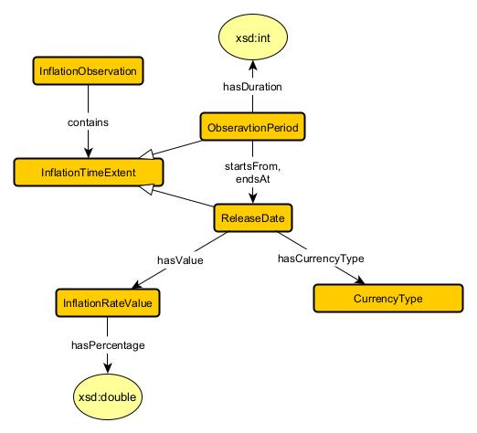
12. Inflation
Inflation impacts movie production and revenue, driving adjustments in budgets, pricing strategies, and investment decisions to maintain profitability.
Source Pattern : Temporal Extent Pattern
Source Data : Global Inflation Dataset, IMDb, TMDb

Slide 27
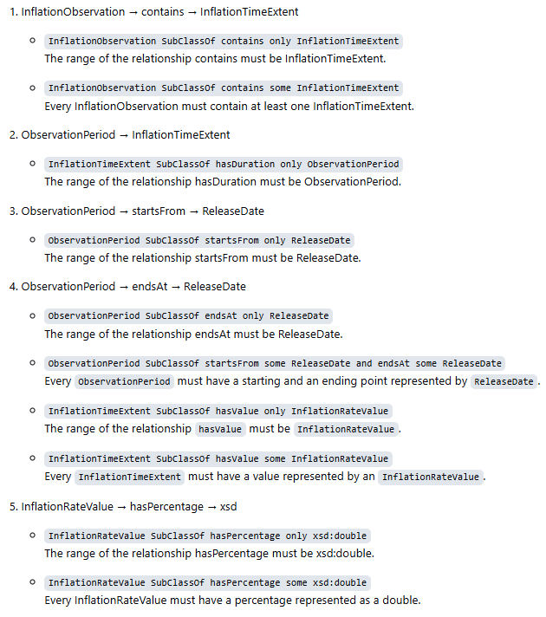
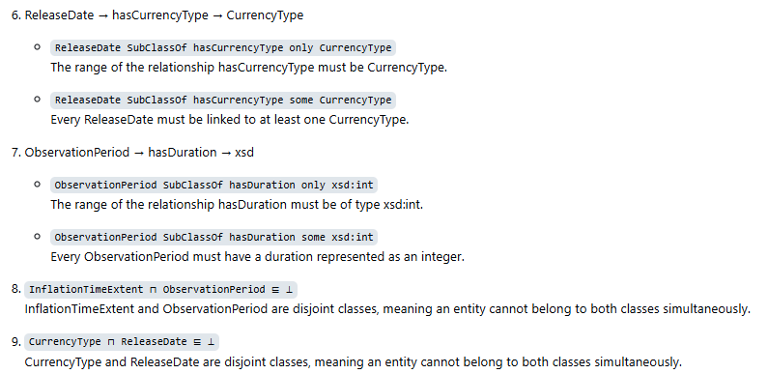
Axioms

Slide 28
AllTogether

Slide 29
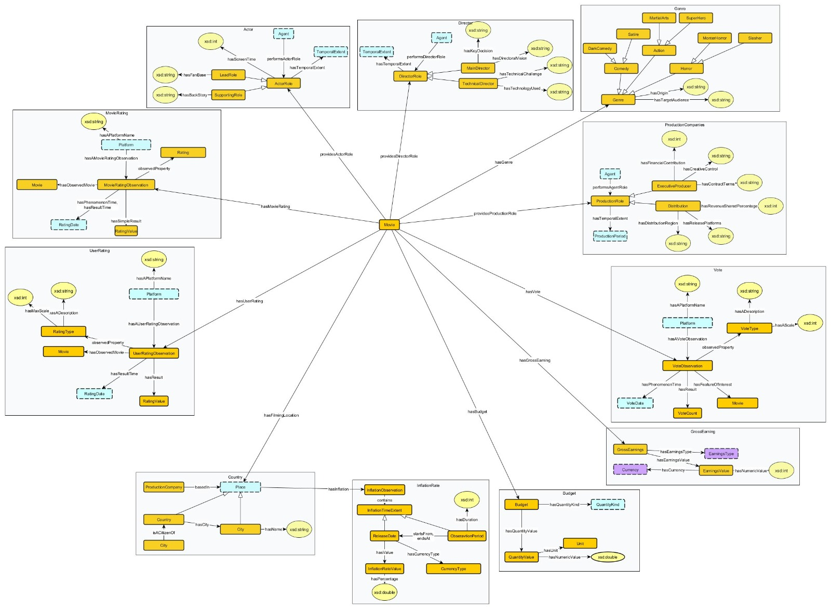
AllTogether

Slide 30
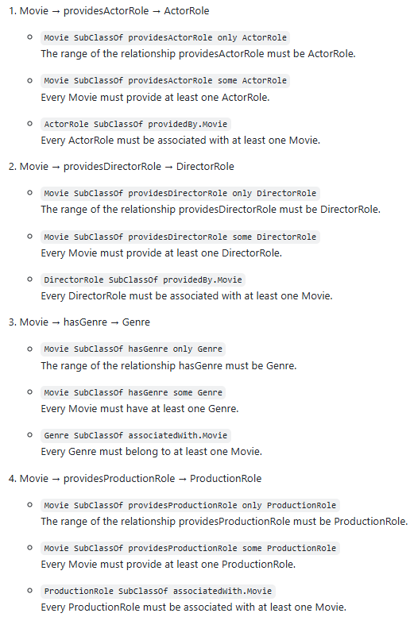
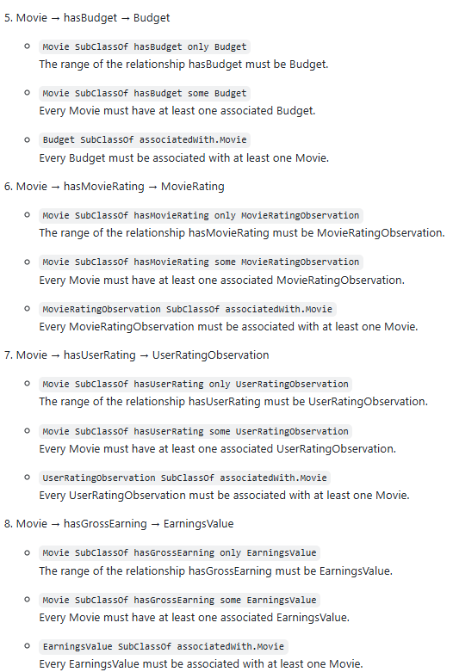
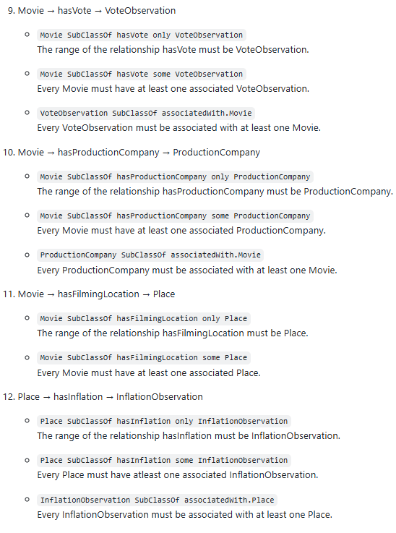
Axioms

Slide 31
Competency Questions

Slide 32
Competency Questions
What are the most common genres for movies featuring a specific actor?
Which actors have appeared in the most movies directed by specific directors?
What is the correlation between a movie’s budget and its gross earnings over different decades?
Which directors have the highest average movie ratings, and how many votes have those movies received?
Which directors have the highest average movie ratings, and how many votes have those movies received?
Which production companies have the highest average gross earnings across all their movies?
Which countries produce the highest-grossing movies?
Which actors have worked in the highest number of high-budget movies, and how did those movies perform in terms of ratings?
How has the inflation rate in each country impacted movie production budgets in that country over time?
Is there a relationship between countries with high inflation rates and the gross earnings or profitability of movies produced in those countries?
Do changes in inflation affect the average vote or ratings of movies released in those countries over the same period?

Slide 33
SPARQL Queries

Slide 34
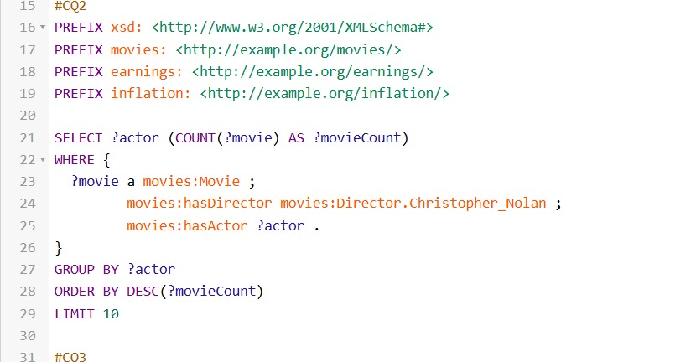
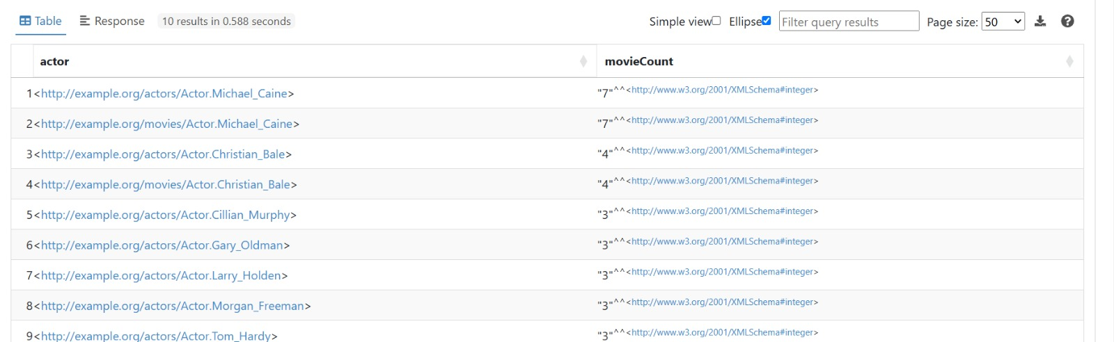
Actors with the Most Appearance in Movies by Specific Directors

Slide 35
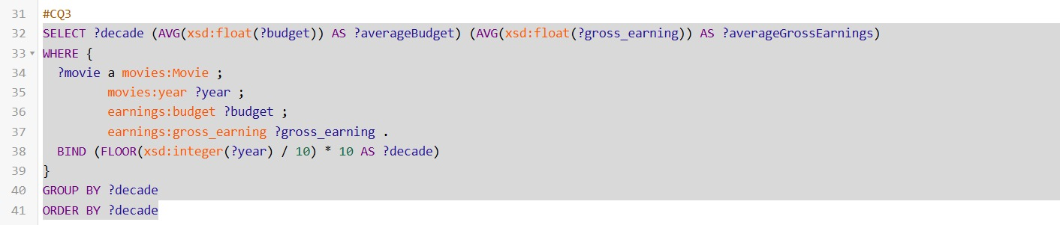
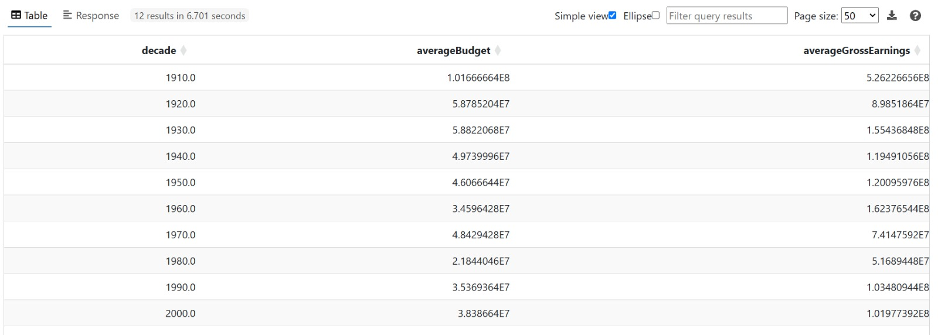
Correlation between Movie’s Budget and Gross Earnings over Decades

Slide 36
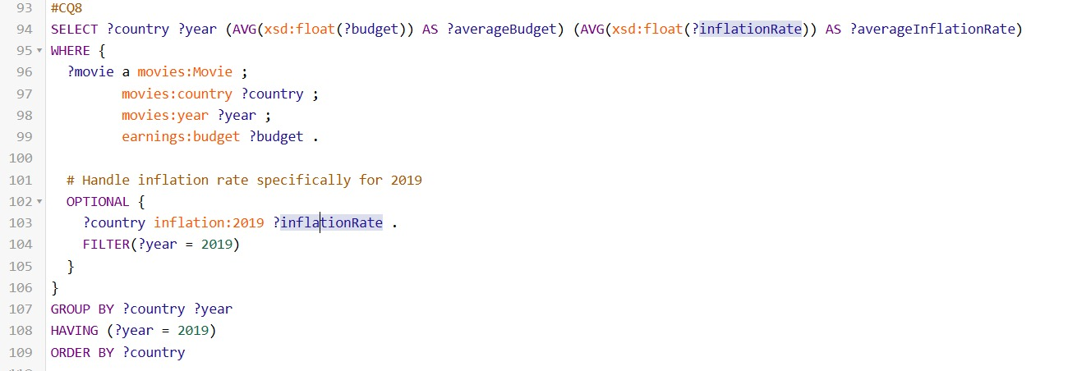
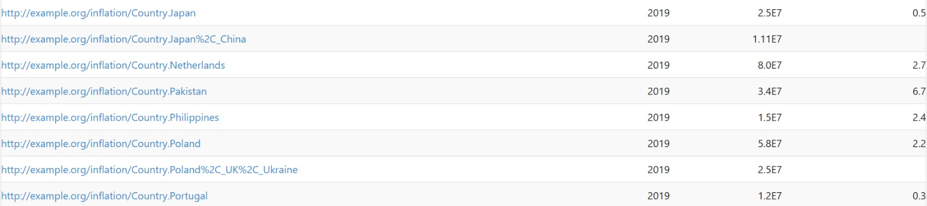
The Impact of Inflation on Movie Production Budgets Over Time by Country

Slide 37
Demo

Slide 38
Retrospective
Pooja’s feedback :
What went well?
The course was well-paced and included clear deliverables and combined lectures to enhance understanding and application of knowledge.
What Could Change?
Giving more time for the materialization part.
Pujan’s feedback :
What went well?
In the end we were somehow able to come up with a knowledge Graph that shows the relation between Movie, Budget, gross-earning and Inflation of the country when certain movies were released.
What Could Change?
Giving a clear picture about how the knowledge graph will look like at the end.
Kedar’s feedback :
What went well?
Got to know more about the schema diagram and axioms and how they fit in the design patterns.
What Could Change? For me everything went well.

Slide 39


